Slide 1




POISSON DISTRIBUTION
SANTOSH CHHATKULI
Copyright: Santosh Chhatkuli

Slide 2
Introduction
It is a discrete distribution and it is only defined for non-negative integers
The Poisson distribution was developed by the French mathematician Simeon Dennis
Poisson in 1837.
The Poisson distribution is most commonly used to model the number of random occurrences of some phenomenon in a specified unit of time or space.
Poisson distribution is helpful in describing the nature of rare events over the period
of time or space
Poisson distribution has found applications in many fields, including distribution of signals, the estimation of bacterial densities, in business to know efficiency and operations, staff management, operation management etc.

Slide 3
Some phenomena that follows PD
The number of misprints in each page of the book.
The number of patients arriving at a physician’s office in a given interval of time.
The number of phone calls received by a telephone operator in a given interval of
time.
The number of customers arriving at the bank’s counter for service in a given
interval of time.
The number of accidents at particular intersection in given time

Slide 4
Difference between BD and PD
In Binomial distribution we are interested in the number of successes and the number of failures out of definite number of trials (n) of a random experiment. But in Poisson distribution the events do not occur as outcomes of a definite number of trials of a random experiment but which occur at random points of time and space (length, area, volume) and interest only lies in the number of occurrences not in its non-occurrences.
In BD we know both no. of occurrences and non-occurrences. In many situations we can count the number of times an event occurs in a given interval of time or space but we don’t know how many times it doesn’t occur. So in PD it is not possible to count the number of failures.
In BD there is fixed no of possible event as n is fixed but in PD number of times an event occurs in given interval of time and space is infinite.

Slide 5
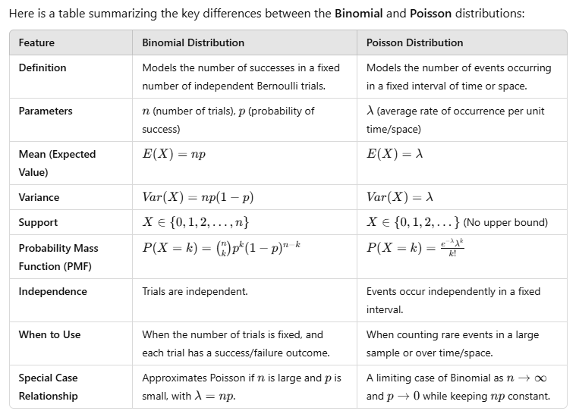

Slide 6
Characteristic of Poisson Distribution (Conditions for Poisson Distribution)
Theoretically, an infinite no. of occurrences of the event is possible in the interval.
Events occur independently. In other words, if an event occurs, it does not affect the probability of another event occurring in the same time period or the other time period.
The average no. of occurrence that occurs in a specified interval is known.
The probability of an event occurring is proportional to the length of the time period.
The probability that a success will occur in an extremely small interval is
virtually zero.

Slide 7
Poisson Formula
The probability of exactly x occurrences in given interval of time or space is given by
_{e}−λ_{λ}x
P( X = x) =
Notations:
x!
𝜆 = Average no. of successes in a given interval time or
space
e = Base of natural logarithm = 2.7183 x = No. of successes desired

Slide 8
Mean and Variance of PD
Mean of Poisson Distribution (µ) = 𝜆
Variance of Poisson Distribution (σ²) = 𝜆
Standard deviation of Poisson Distribution (σ) = 𝜆
Hence, unique thing about PD is that its mean and variance are equal
Note: 𝜆 is only parameter of PD. A Poisson distribution is completely specified if we known the value of 𝜆.

Slide 9
Example: Customers arrive at a photocopying machine at an average rate of two every 10 mins interval. The no. of arrivals is distributed according to a PD. What is the probability that:
There will be no arrivals during any period of ten minutes
There will be exactly one arrival during this time period
There will be two or more than two arrivals during this time period Solution:
X = No. of arrivals at a photocopying machine in every 10 mins
λ = Average no. of arrivals at a photocopying machine in every 10 mins
We know,
−𝜆 𝑥 −2 𝑥
P(X = x) = ^{𝑒 𝜆} = ^{𝑒 2}
𝑥! 𝑥!
−2 0
P(X = 0) = ^{2.7183 2} = 0.1353
0!
−2 1
P(X = 1) = ^{2.7183 2} = 0.2707
1!
P(X ≥ 2) = 1 – P(X < 2) = 1 – {P(X = 0) + P(X = 1)} = 1 – 0.1353 – 0.2707 = 0.594

Slide 10
Poisson distribution as an approximation of the Binomial distribution:
Poisson distribution is appropriate when there is a small probability of a single event, this distribution is very similar to the binomial distribution when n is large and p is small (close to zero) so that q = 1-p is close to 1. If such conditions are met Poisson distribution can be a reasonable approximation of the Binomial distribution.
Poisson distribution is limiting case of Binomial distribution when either of the following condition is met:
n ≥ 20 and p ≤ 0.05
n ≥ 50 and n p < 5
n p < 5 and p < 0.5
In such case we can substitute the mean of Binomial distribution (n p) by mean of the Poisson distribution (λ) and we can use following mathematical formula.

Slide 11
Example: In a certain factory turning out optical lenses, there is a small chance 1/500 for a lens to be defective. The lenses are supplied in a packet of 10. Use Poisson distribution to calculate the approximate number of packets containing no defective, one defective and two defective lenses in a consignment of 20,000 packets.
Solution:
Here, r.v. X = No. of defective lenses in a packet of 10
Probability of a lens being defective (p) =
1
= 0.002
500
Probability of a lens being non-defective (q) = ⁴⁹⁹ = 0.998
500
The random variable X ~ BD (n = 10, p = 0.002)
Here, we can approximate probabilities by using Poisson distribution since condition to use Poisson distribution as an approximation of BD is met.
Mean no. of successes (𝜆) = n p = 10 𝑥
Probability of x successes is given by,
1
= 0.02
500
𝑃 𝑋 = 𝑥
−𝑛𝑝 𝑥 −0.02 𝑥
₌ 𝑒 (𝑛𝑝) ₌ (2.7183) (0.02)
𝑥! 𝑥!

Slide 12
Numerical: For the case of the thin copper wire, suppose that the number of flaws follows a Poisson distribution with a mean of 2.3 flaws per millimeter.
Determine the probability of exactly two flaws in 1 millimeter of wire.
Determine the probability of 10 flaws in 5 millimeters of wire.
Determine the probability of at least one flaw in 2 millimeters of wire.
Solution:
Let X denote the number of flaws in 1 millimeter of wire.
Then, λ = 2.3 flaws
−2.3 2
Probability of exactly two flaws = P (X = 2) = ^{𝑒 2.3} = 0.265
2!
(b) In the second case the interval is increased by 5 fold. Then, X denotes the no. of flaws in 5 mm of wire and X has a Poisson distribution with λ₁ = λ x 5 = 2.3 x 5 = 11.5 flaws per 5 mm of wire.
−11.5 10
Probability of 10 flaws = ^{𝑒 11.5} = 0.113
10!
(c) Let X denote the number of flaws in 2 millimeters of wire. Then X has a Poisson distribution with
λ₂ = λ x 2 = 2.3 x 2 = 4.6 flaws/2 mm of wire.
−4.6 0
Probability of at least one flaw = P (X ≥ 1) = 1 - P (X = 0) = 1 - ^{𝑒 4.6} = 0.9899
0!

Slide 13
(a) Probability of zero defective = P (X = 0) = ^{(2.7183) (0.02)} = 0.9802
−0.02 0
0!
Expected no. of zero defective in a consignment of 20,000 packets
= N . P(X = x) = 20,000 x 0.9802 = 19,604
−0.02 1
(b) Probability of one defective = P (X = 1) = = ^{(2.7183) (0.02)} = 0.019604
1!
Expected no. of 1 defective lenses in a consignment of 20000 packets
= 20000 x 0.019604 = 392.08 = 392 appx
−0.02 2
(c) Probability of one defective = P (X = 2) = = ^{(2.7183) (0.02)} = 0.00019604
2!
Expected no. of 2 defective lenses in a consignment of 20000 packets
= 20000 x 0.00019604 = 3.9008 = 4 appx

Slide 14
Fitting of a Poisson Distribution
A doctor collected following data about the arrival of patients in his clinic for 445 days. Fit a Poisson Distribution for the data.
No. of patients (X) | 0 | 1 | 2 | 3 | 4 | 5 | 6+
No. of days (f) | 153 | 169 | 72 | 31 | 12 | 6 | 2

Slide 15

Solution:
Here, random variable X = No. of patients visiting the doctor
Sample size (N) = 445
The distribution to be fitted is Poisson distribution having following probability mass function.
$P\left(X=x\right)=\frac{e^{−λ} λ^{x}}{x!}$ x = 0, 1, 2, …
Mean $\overline{X}=\frac{\sum{fx}}{\sum{f}}$ = $\frac{564}{445}$ = 1.27
Mean of P.D. (λ) = 1.27
X | 0 | 1 | 2 | 3 | 4 | 5 | 6 | Total
f | 153 | 169 | 72 | 31 | 12 | 6 | 2 | 445
f X | 0 | 169 | 144 | 93 | 48 | 30 | 12 | 564

Slide 16
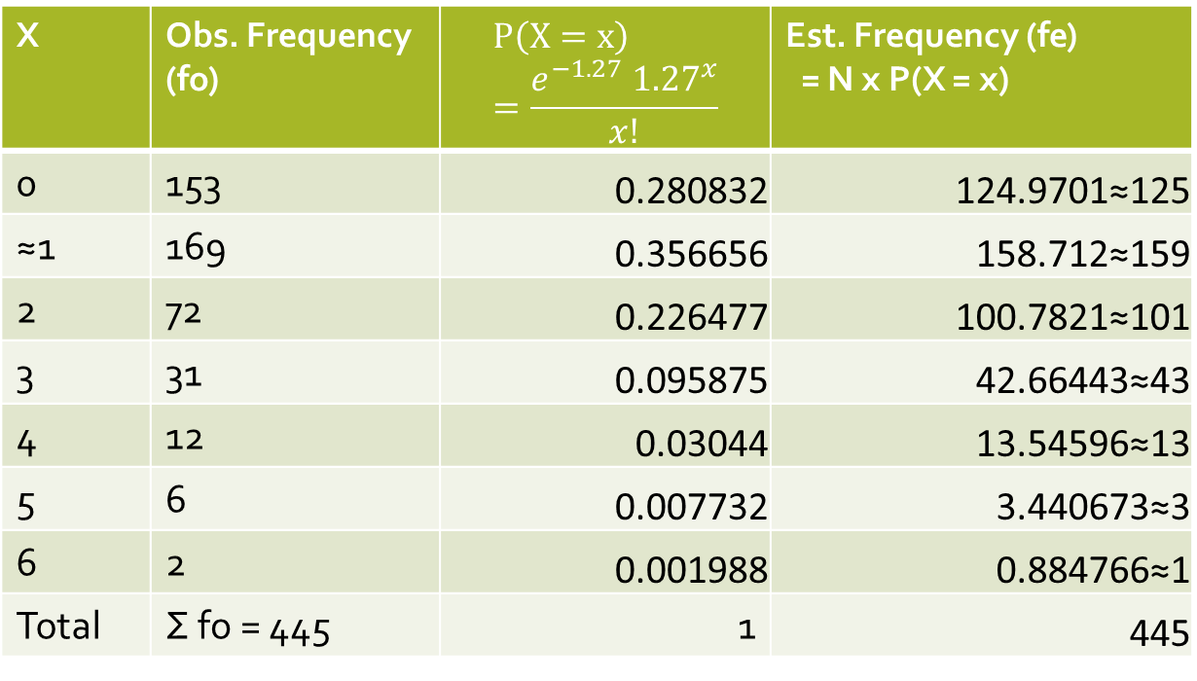

$$P\left(X=x\right)=\frac{e^{−λ} λ^{x}}{x!}=\frac{e^{−1.27} {1.27}^{x}}{x!}$$
Estimated frequency (fe) = N . P(X = x)
X | Obs. Frequency (fo) | $$P\left(X=x\right)=\frac{e^{−1.27} {1.27}^{x}}{x!}$$ | Est. Frequency (fe) = N x P(X = x)
0 | 153 | 0.280832 | 124.9701≈125
≈1 | 169 | 0.356656 | 158.712≈159
2 | 72 | 0.226477 | 100.7821≈101
3 | 31 | 0.095875 | 42.66443≈43
4 | 12 | 0.03044 | 13.54596≈13
5 | 6 | 0.007732 | 3.440673≈3
6 | 2 | 0.001988 | 0.884766≈1
Total | Σ fo = 445 | 1 | 445

Slide 17
Ten percent of the tools produced in a certain manufacturing process turn out be defective. Find the probability that in a sample of 10 tools chosen at random, exactly two will be defective by using (a) the Binomial distribution (b) the Poisson approximation to the binomial distribution.
2. Contamination is a problem in the manufacture of magnetic storage disks. Assume that the number of particles of contamination that occur on a disk surface has a Poisson distribution, and the average number of particles per square centimeter of media surface is 0.1.
The area of a disk under study is 100 square centimeters. Determine the probability that 12 particles occur in the area of a disk under study.
Determine the probability that 12 or fewer particles occur in the area of the disk under study.
3. The number of cracks in a section of interstate highway that are significant enough to require repair is assumed to follow a Poisson distribution with a mean of two cracks per mile.
What is the probability that there are no cracks that require repair in 5 miles of highway?
What is the probability that at least one crack requires repair in half mile of highway?

